Slide 1
“Advanced VMs”
Or: How you learned to stop worrying and learn system administration
Christian Beam and Zack Orndorff
Notes:
Christian

Slide 2
What we’re doing today
The “beginner” session is covering the basics of what a VM is and how you might install one.
We’re going to use VMs to learn other stuff
Opinion: One of the best ways to learn to secure something is to be able to set it up from scratch.
Notes:
Christian
Today is going to be about services, how they are installed, configured, and secured.
This is the approach we apply to practicing for CCDC, and we recommend trying it.
These are the bread and butter of CCDC, and just about every company network that exists.

Slide 3
Outline
Quick review of VMs
Introduce the lab
Explain the packages we’ll be working with:
CentOS
SSH
BIND (a DNS server)
Gogs (a Git server)
Nginx (an HTTP server)
Notes:
Zack -
We want to give you an idea of what you’re configuring so you aren’t doing it blindly

Slide 4
Quick review of VMs
They’re a thing
You use them to simulate having more than one computer when you’re a poor college student
Or if you just plain don’t have a ton of room for PCs
Notes:
Christian
A VM is your best friend! Want to download some malware samples and not trash your own computer? Want to test out a new linux distribution? Don’t want to install Kali on bare metal (I.E. your actual computer)?
Then learn how to use VMs!
You need to be able to sandbox malicious programs and attacks to ensure they do not spread to the internet, and get you put in Jail.
Want to practice your red team skills (IE offensive)? Install two vms, isolate them to an internal network, ip them, and then have fun!
VM Terminology:
-Bare metal vs virtual

Slide 5
Today’s lab
We’ll be setting up a VM capable of serving web sites and Git repositories, as well as providing DNS so you don’t have to use IP addresses.
Notes:
Christian - What we will be doing

Slide 6
CentOS
Basically Red Hat Enterprise Linux (RHEL), only recompiled and made freely available
Yes, this is legal
More enterprise-y Linux distro
Not in a bad way necessarily
Offers long-term stability
Notes:
Christian
This is possible because Free Software licenses require Red Hat to release most of their sources anyway, so they’re nice and release the rest while they’re at it
RHEL and CentOS are popular in big companies b/c of support
<insert comment about GL being CentOS 6 and still getting patches>
RHEL 5 just hit EOL last year, a while after 7 was released.

Slide 7
SSH
Secure Shell (SSH) is a cryptographic network protocol for network services to use over an unsecured network
The best example is the remote login application you use to login into UMBC’s GL servers (ssh user@some-ip-or-domain)
Even though it has the word ‘secure’ in its name, does not mean it is always secure
Certain SSH configurations will make you vulnerable to attack
We will show you a more secure configuration than just the default
Notes:
Christian
It’s Zack’s favorite UNIX tool :D
It is not just used to login users remotely!
Scp/winscp
git/gogs
Certain bad configs:
PasswordAuthentication
RootLogin (in certain situations where logging in remotely as root is a bad thing or unnecessary)
Port 22

Slide 8
DNS: Domain Name System
That thing that maps names to IP addresses
Hierarchical
Data is stored in zones
There are also reverse zones that map IPs to names
Notes:
Zack
It’s that thing that maps names to IPs. I don’t need to explain that to this group
Runs on UDP and TCP port 53
Hierarchical
So there are root servers that contain the root zone, containing the nameservers for com, net, org, etc
Each TLD runs nameservers that can tell you about domain.themself
Then if you register a domain, you can have your registrar return your IP as your nameserver
And you can write your own zone file
Reverse zones are useful if you forget which server is which… or if you need to ID a server for spam filtering

Slide 9
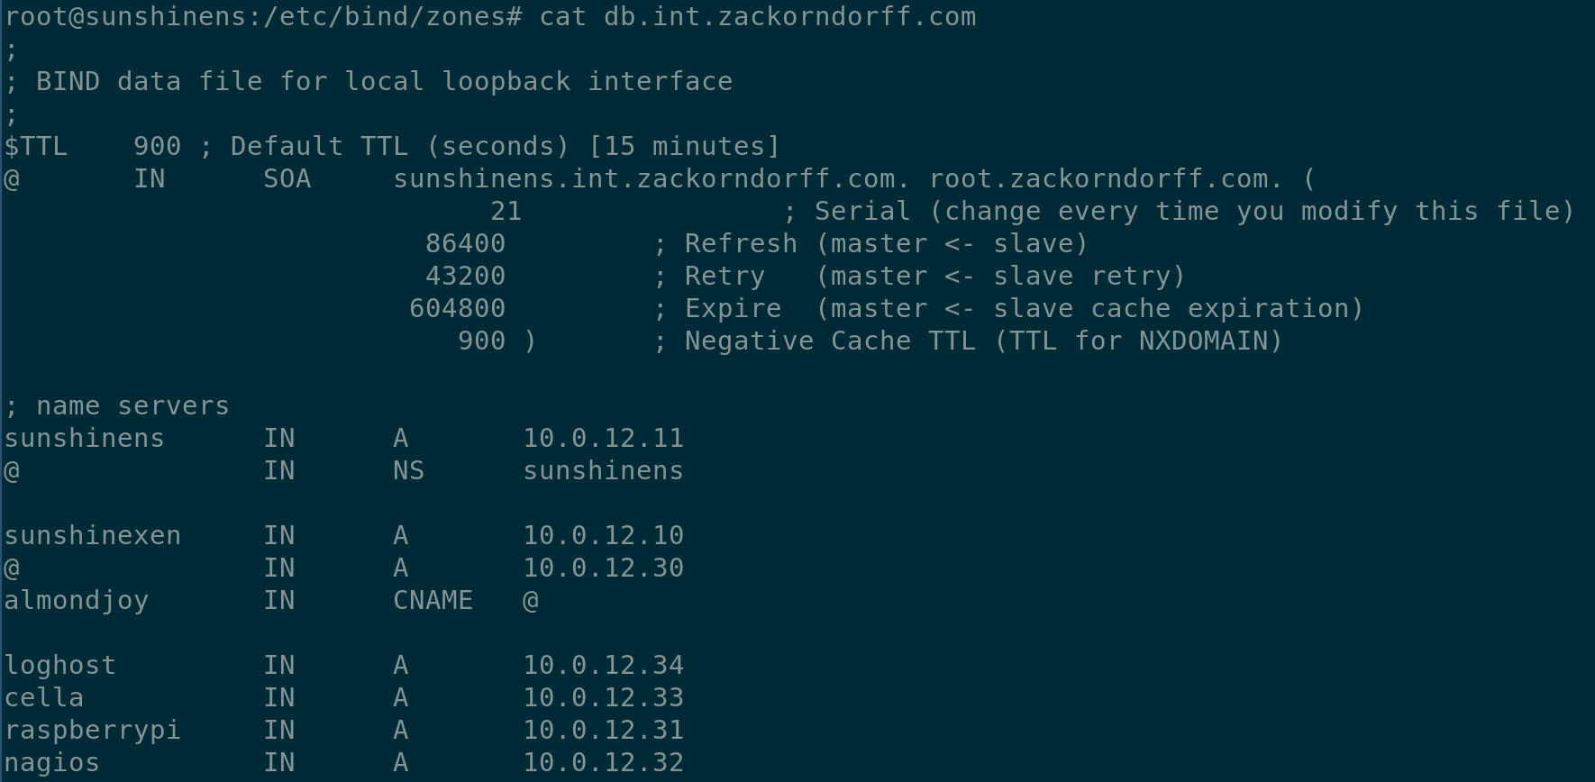
Notes:
Zack
Let’s go thru the parts
TTL - time to live. How long an affirmative response can be cached
All times in seconds
SOA = start of authority
Zone name then some sort of email address IIRC
Serial number is actually important
Columns: name (relative unless it ends with dot) @ is the root of the file.
Record class IN for internet (CH for Chaosnet used to be a thing lol)
Record type:
A (Address)
AAAA or quad-A (IPv6 address)
CNAME - canonical name (kinda like an alias)
TXT - used for DKIM, identity verification, etc
NS - name server
PTR - reverse lookups
Last column is where it points

Slide 10
MySQL (MariaDB)
MySQL is a open-source relational database management system
MariaDB is a fork of MySQL
Insecure databases that are open to the internet for anyone to attack, are everywhere
You don't want your DB to ever end up in the media like this
It’s 2017 people, it is time to secure your DBs; fortunately for us, MariaDB comes shipped with a security script which will configure certain security features for you DB
Best way to secure your DB though, is with a firewall.
Notes:
Christian
Its name is a combination of "My", the name of co-founder Michael Widenius's daughter,[8] and "SQL", the abbreviation for Structured Query Language -- WIKIPEDIA
Fork - take the original project and adapt it to your needs? (Zack maybe you can explain this better)

Slide 11
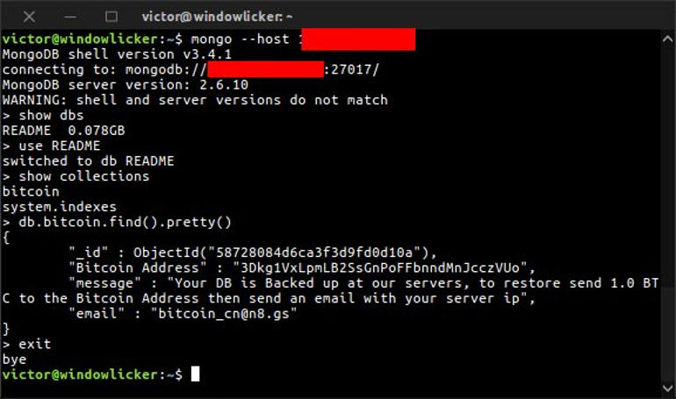
Notes:
Christian

Slide 12
Git
Useful commands:
git init
git clone
git add <thing>
git commit
git diff
git checkout
git remote
git push
git pull
git branch
git merge
To see man pages, do man git-add
It’s a decentralized version control system (DVCS)
Predecessors include RCS, CVS, SVN, BitKeeper
Competitors include Mercurial, Perforce, SVN
The data model for Git is kinda interesting
Directed Acyclic Graph (DAG) of commit objects
Each of those has metadata and points to a tree object
Tree objects can point to other trees as well as blobs.
Blobs are your files
A branch or tag, is just a pointer to a commit.
You can push and pull commits to and from other machines, such as your server :D
Notes:
Zack
Decentralized enables many use cases -- for one, you can code on an airplane and still be able to diff, commit, recover old versions, etc.
If you want to know more about the data model, read the “Git internals” chapter of the free “Pro Git” book by Scott Chacon. I find Git makes a lot more sense when you think about it as intended.
Typical workflow:
git init or git clone
Change stuff
git add files to index
git commit (it opens your editor)
git push
You can do branches and merge them

Slide 13
nginx
HTTP server
Reputation of being faster than Apache
We’re using it as a reverse proxy
Notes:
Both

